Slide 1
Intra School Competition Programme
VIRTUAL SCHOOL GAMES
Tennis
@McrschoolsPE #Manchestervirtualschoolgames

Slide 2
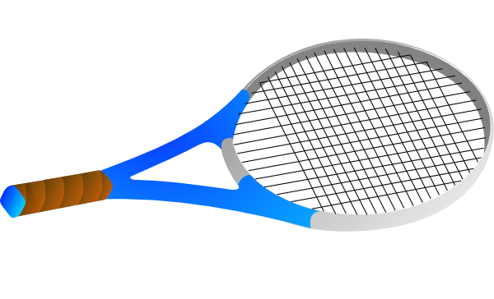
Station 1: Tennis racket relay
Equipment & Set Up
How to Play
Teams of 6 players
All players line up in a straight line behind line A
Activity set out as per diagram
The first 3 players in line have a Tennis racket each
Equipment: 4 marker cones, 3 tennis rackets, stopwatch
Player 1 runs to line B with their racket and places it flat on the ground with the base of the handle touching line B. They then run back and high 5 player 2
Place the cones in a straight line 10m apart
Player 2 runs and places their racket so ½ of the handle lies on top of player 1’s racket before running back to high 5 the next player.
Sports Leaders to co-ordinate and score
Scoring: Record the total number of completed relays achieved by the team in 5 minutes
Player 3 repeats and high 5’s player 4. Player 4 doesn’t have a racket so runs and picks up Player 1’s racket and re-places it at the front of the line of rackets.
A
B
C
This continues until the line of tennis rackets crosses line C
Players then collect all tennis rackets and return to line A to repeat as many times as possible in 5 minutes
5m
10m

Slide 3
Station 2: zig zag pick up
Equipment & Set Up
How to Play
Teams of 6 players
Position 3 players behind both cones A and B facing towards each other
Activity set out as per diagram
Player 1 starts from cone A and runs to cone 1, picks up the ball and places it on cone 2
Equipment: 8 marker cones, 3 tennis balls, stopwatch
Place the cones in a zig-zag shaper 2m apart and place a ball on 3 cones as shown
Continuing to cone 3 picking up the ball and placing it on cone 4, then to cone 5 picking up the ball and placing on cone 6
Sports Leaders to co-ordinate and score
They then run to High 5 the first player waiting at cone B who repeats in reverse cones 6>5, 4>3, & 2>1 before high fiving the next player waiting at cone A
Scoring: Record the total number of relays the team completes in 5 minutes
The team then complete as many zig zag relays as they can in 5 minutes
A
B
A test of speed, agility and co-ordination
Keep low as you approach and pick up the balls then push off your leg towards the next cone

Slide 4
Station 3: Balancer / bouncer relay
Equipment & Set Up
How to Play
Teams of 6 players
Players line up behind cone A in a straight line
Activity set out as per diagram
BALANCER: Player 1 places the ball on their tennis racket and travels to and around cone B and back before handing the ball to the next player waiting in line
Equipment: 2 marker cones, 1 tennis ball, stopwatch
Place the cones in a straight line 7m apart as shown
The next player completes the same relay and then the team complete as many relays as they can in 5 minutes
Sports Leaders to co-ordinate and score
BOUNCER: As per the balancer relay but players should bounce the ball upwards on their racket when completing the relays
Scoring: Record the total number of relays the team completes in 5 minutes. Do not count any relays where the ball is dropped.
If the ball is dropped at any point during an individual the relay it should be taken back to the start for the next person to have their go
A
B
Players can walk, jog or run but must keep the ball on or bouncing on the racket
Suggestion: If the BALANCER relay is to easy Challenge students to complete the BOUNCER relay
Keep your racket level and still. When bouncing keep it just above waist height and flick your wrist to create bounce

Slide 5
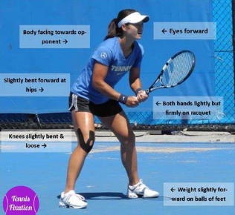
Station 4: ready position side taps
Equipment & Set Up
How to Play
Teams of 6 players
Players start from a stationary READY position half way between the 2 cones holding the racket with BOTH hands
Activity set out as per diagram
Each player has 1 minute to complete as many side taps as possible
Equipment: 2 marker cones, tennis racket, stopwatch
Place the cones in a straight line 4m apart
SIDE TAPS: From your start point sideways skip (by bringing you feet together) left and right to each cone
Sports Leaders to co-ordinate and score
At cone B take your LEFT hand off the racket and reach down to tap the cone
Scoring: Record the total number of side taps each player completes in 1 minute and calculate the team total.
At cone A take your RIGHT hand off the racket and reach down to tap the cone
Remain in the READY position at all times as you side skip between the cones always passing through the start point
A
B
Right hand tap
Left hand tap
Avoid waiting time by having 2 players complete this activity at the same time with the others counting
4m
Ready Position

Slide 6
Station 5: throw-hit-catch
Equipment & Set Up
How to Play
Teams of 6 players – split into 3 pairs
In Pairs one player is the FEEDER and the other is the HITTER. Taking it in turn to perform both roles.
Activity set out as per diagram
The ball is fed UNDERARM by the feeder bouncing once for the hitter to return with either a Forehand or Backhand stroke
Equipment: 2 marker cones, 1 tennis ball, 1 tennis racket per pair and a stopwatch for the Timer
Place the cones 3m apart for each pair
Challenge: The ball is fed UNDERARM by the feeder (no bounce) for the hitter to return with a forehand or backhand VOLLEY stroke
Sports Leaders to co-ordinate and score
Scoring: Record the total number of return catches made by the Feeder in 1 minute and calculate the Team total.
The ball MUST be caught by the feeder before bouncing for a point to be scored
Pairs take it in turns to Feed and Hit. Hitters have 1 minute to return as many balls as possible to their partner.
Test of ACCURACY and CONTROL
A
B
Watch the ball and get your body into the correct shape to hit Forehand and Backhand shots & volleys
Suggestion: 1 BOUNCE feed. Challenge: VOLLEY feed

Slide 7
Station 6: underarm serving
Equipment & Set Up
How to Play
Teams of 6 players
Players serve one at a time with all others waiting at the ‘wait cone’.
Activity set out as per diagram
Players can bounce the ball once before Serving
Challenge: Players should Volley serve (no bounce before hitting)
Equipment: Marker cones, 1 tennis racket, 2/3 tennis balls, Hula hoop or similar target.
Place the hoop 4m away (Y3/4) & 5m away (Y5/6)
Players aim to Serve the ball UNDERARM to land in the target without bouncing
Sports Leaders to co-ordinate and score
Each player has 5 continuous attempts
Scoring: Record the total number of serves hitting the target (without bouncing) for each Team
Test of ACCURACY and CONTROL
Balanced side on stance when serving holding the
ball next to the racket
A
wait cone
Downward backswing, hitting up/forward to serve and following through
Suggestion: BOUNCE serve. Challenge: VOLLEY serve

Slide 8
Team score sheet
SCHOOL: YEAR GROUP:
ACTIVITY STATION | TEAM SCORE
1. TENNIS RACKET RELAY
2. ZIG-ZAG PICK UP
3. BALANCER / BOUNCER RELAY
4. READY POSITION SIDE STEPS
5. THROW-HIT-CATCH
6. UNDERARM SERVING
TOTAL TEAM SCORE

