Slide 1
Intra School Competition Programme
VIRTUAL SCHOOL GAMES
football
@MCRSCHOOLSPE #MANCHESTERVIRTUALSCHOOLGAMES

Slide 2
Station 1: kicking / lofted pass
Equipment & Set Up
How to Play
Teams of 6 players
Players have 3 consecutive kicks from between the yellow marker cones
Activity set out as per diagram
All other players wait their turn at the wait cone
Equipment: marker cones, footballs x3
Players kick the ball forward in the air into the scoring zone
Place the cones in a straight line 10m apart
Sports Leaders to co-ordinate and score
Points are awarded on where the ball first lands
Scoring: Record each players total score and add together to calculate the overall team score.
A players score is the total points from their 3 kicks
Non striking foot to be planted next to the ball on approach
Head still over the ball as striking
Follow through, kicking through the ball

Slide 3
Station 2: dribbling / RUNNING WITH THE BALL
Equipment & Set Up
How to Play
Teams of 6 players
One at a time players start at cone 1 and travel with the ball to and around cone 2 and back to cone 1
Activity set out as per diagram
They repeat to complete as many times as possible in 1minute
Equipment: marker cones, footballs
Place the cones in a straight line 5-10m apart depending on age group
After 1 minute the next player waiting has their go
Two players can complete this station alongside each other if necessary – just ensure each player has their own cones to dribble around
Sports Leaders to co-ordinate and score
Scoring: Record each players total number of
dribbles and add together to calculate the team total.
Record each players total number of dribbles in 1 minute
Keep the ball in front of you pushing it forward with the ‘laces’ on either foot
Head up - be aware of where you are going
Tighter control around the cone with the inside or outside of your foot

Slide 4
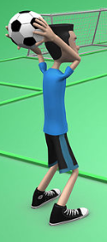
Station 3: throw in
Equipment & Set Up
How to Play
Teams of 6 players
Players have 3 consecutive throws (Throw Ins) from behind the throw line
Activity set out as per diagram
All other players wait their turn at the wait cone
Equipment: marker cones, footballs x3
Place the cones in a straight line at
marked distances
Players hold the ball in two hands behind their head and throw up & forward bringing the ball over their head
Sports Leaders to co-ordinate and score
Points are awarded on where the ball first lands
Scoring: Record each players total score and add together to calculate the overall team score.
A players score is the total points from their 3 throw ins
Hold the ball with two hands (as per picture)
Keep both feet on the ground when throwing
Release the ball as it comes over your head and follow through with your arms

Slide 5
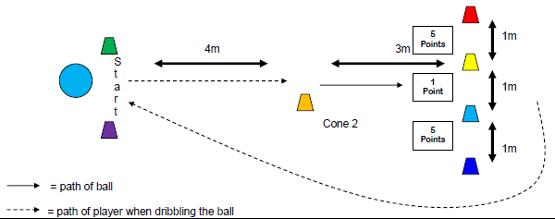
Station 4: dribble & shoot
Equipment & Set Up
How to Play
Teams of 6 players
One at a time players start behind the start line and dribble the ball to cone 2
Activity set out as per diagram
Players stop the ball at cone 2 and take a shot at ‘goal’ before running back to the start for their 2nd go
Equipment: marker cones, x3 footballs
Each player has 3 consecutive attempts
Sports Leaders to co-ordinate and score
Players should aim for the ‘corner’ of the goal to score higher points
Scoring: Record each players total score and add together to calculate the team total.
Record each players total score from their 3 attempts
Dribbling - keep close control of the ball from the start to cone 2
Shooting – decide which part of the goal you are going to aim for
Strike with the ‘laces’ for power or inside of the foot for placement

Slide 6
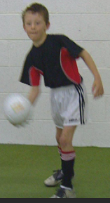
Station 5: goalkeeper roll
Equipment & Set Up
How to Play
Teams of 6 players
Players have 3 consecutive UNDERARM throws / rolls from behind the roll line
Activity set out as per diagram
All other players wait their turn at the wait cone
Equipment: marker cones, football
From stationary, hold the ball in one hand and roll the ball forward towards the targets (as per picture)
Sports Leaders to co-ordinate and score
Scoring: Record each players total score
and add together to calculate the overall team score.
Higher points awarded for accuracy and rolling the ball through the centre of the target zone
A players score is the total points from their 3 throws / rolls
Hold the ball balancing it on the fingers of one hand
8m
1m
Step forward with your opposite leg and bend
it at the knee to lower you body position
Stay low as you roll the ball and follow through with your arm as you release

Slide 7
Station 6: dribble RELAY
Equipment & Set Up
How to Play
Teams of 6 players
Three players to start at each end of the relay run
Activity set out as per diagram
Player 1 starts with the ball at the start line and dribbles in and out of the cones to Player 2 at the other end
Equipment: marker cones, football
Modify the set up below by having 3 players start at each end to complete 1 relay at a time (this will maximise players goes in the time period)
Player 2 dribbles back through the cones to player 3 and so on so that all players have a go
The team has 5 minutes to complete as many relay dribbles as possible
Sports Leaders to co-ordinate and score
Scoring: Record the total number of completed dribble relays in 5 minutes.
Record the total relays that the team completers in 5 minutes
Keep the ball close but in front of you using
the inside & outside of your foot to move through
the cones
Head up - be aware of the cones and where you are going

Slide 8
Team score sheet
SCHOOL: YEAR GROUP:
ACTIVITY STATION | TEAM SCORE
1. KICKING / LOFTED PASS
2. DRIBBLING
3. THROW IN
4. DRIBBLE & SHOOT
5. GOALKEEPER ROLL
6. DRIBBLE RELAY
TOTAL TEAM SCORE

