Slide 1
Virtual school games intra school competition programme
basketball
@MCRSCHOOLSPE
#MANCHESTERvirtualschoolgames

Slide 2
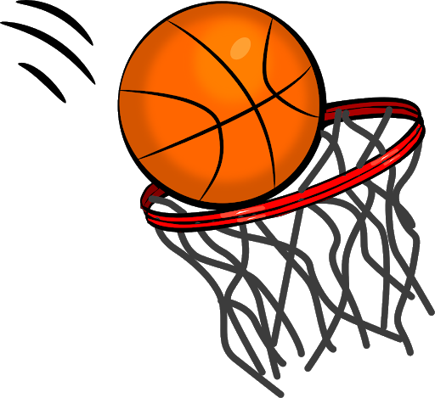
Station 1: dribble slalom
Equipment & Set Up
How to Play
Players take it in turns to dribble in & out through the course of cones to the end one before dribbling the ball back and passing to the next player waiting behind the first cone
5 minutes continuous game play
Teams of 5 players
One Basketball per team
Marker cones
Place the marker cones in a straight line 3m apart
Scoring: 1 point for each completed dribble
Dribble with one hand (use fingers to control the ball)
Position the ball in front of you when dribbling
Bounce the ball to waist height
Look up not down at the ball

Slide 3
Station 2: basketball golf
Equipment & Set Up
How to Play
Players take it in turn to complete each hole
To complete a hole players all start from the first cone (hole 1) taking one shot in turn
If a player scores a basket / hits the wall target they move onto the next hole (cone 2) and so on. If they miss they stay on hole 1until they score
The PAR for each hole is 4 so if a player does not score after 4 attempts they move automatically move onto the next hole
The game ends once all players have completed all 5 holes or all players have had 4 shots at each hole
Teams of 5 players
One Basketball per team
Marker cones or Floor spots
Basketball Hoop(s) or Wall target(s)
Scoring: Add up the total number of shots it takes the whole team to complete the 5 ‘holes’. The lowest team score is the best score.
Hole 1 > > > 5
TIP: Up to 3 teams can
shoot into the same hoop
(adds to the fun). Set this
up from different angles in
front of the hoop
Align yourself with the hoop / target
Keep your eyes on the hoop / target
Position the ball on your fingertips
1m
1.5m
2m
2.5m
3m
‘Small to Tall’ posture when shooting

Slide 4
Station 3: catching circle
Equipment & Set Up
How to Play
A Teacher, TA or Sports Leader stands at the centre of a circle surrounded by members of the team
The ball is thrown to each player in turn (i) Bounce Pass (ii) Chest Pass. Players catch and make the same return pass to the thrower.
3 minutes to be allocated for game play & 1 point awarded for each successful catch
Teams of 5 players
One Basketball per team
Marker cones or Floor spots
Team to form a circle around a central person 4m away
Scoring: Add up the total number of Bounce Pass & Chest Pass catches each team member completes
Balanced READY position
TIP: If limited in terms of sports leaders or adult help have teams double up on each cone to avoid players waiting long periods for their go
Hands/Fingers in ‘W’ shape
Eyes on the ball
Catch & pull the ball into your body

Slide 5
Station 4: dribble & shoot relay
Equipment & Set Up
How to Play
Players line up in a straight line behind their starting cone 6m from the basket or wall target
Players in turn dribble the ball to their hula hoop placed 2m away from basket
Players stop just before their hula hoop and jump into it landing on two feet and pivoting before shooting at the basket or wall target
Players then retrieve their ball and dribble back to their team passing the ball to the next player to have their go
5 minutes continuous game play for this activity
Teams of 5 players
One Basketball per team
Marker cones or Floor spots and Hula Hoops
Basketball Hoop(s) or Wall target(s)
Scoring: 2 points for each basket or wall target hit. Add up the total number of points that the team scores in 3 minutes
TIP: Up to 3 teams can dribble & shoot into the same basket (adds to the fun).
Set this up from different angles in front of the basket
Remember the dribbling key points
Remember the shooting key points
1.5m or 2m
6m

Slide 6
Station 5: target bounce relay
Equipment & Set Up
How to Play
Players line up 3 behind one cone and 2 behind the other cone facing towards each other
The first player Bounce Passes the ball to the opposite player aiming to land the ball so that it bounces on the floor sport and reaches their partner after just one bounce. They then go to the back of their line.
The player opposite catches the ball and bounce passes the ball back to the next player opposite and goes to the back of their line
This passing ‘rally’ then continues for 3 minutes
Teams of 5 players
One Basketball per team
Floor Sports
Stand players 5m apart facing each other with a floor spot in the middle of them
Scoring: 1 point for each time the ball is passed and bounces on the spot plus an extra point if the ball is caught after one bounce by their team mate
Grip with 2 hands & use your fingers to push the ball away from your body
Step forward with one foot as you pass the ball
Follow through on release extending your arms

Slide 7
TEAM Score sheet
School: Year Group: Team name:
Activity Station | Team Score
1. Dribble Slalom
2. Basketball Golf
3. Catching Circle
4. Dribble & Shoot Relay
5. Target Bounce Relay
TOTAL TEAM SCORE

