Slide 1
Maximising the Sport Premium Funding

Slide 2
ROLE
Ensuring clarity of vision, ethos and strategic direction
Holding the HT to account for the educational performance of the school and its pupils
Overseeing the financial performance of the school and making sure its money is well spent
Notes:
New framework – change in evaluation schedule – recognition that leadership and management is the driving force supporting improvement in all areas of the school
Change in order of evaluation schedule
Overall effectiveness – the quality of education
Quality of leadership and management
Behaviour and safety of pupils
Quality of teaching and learning
Achievement of pupils

Slide 3
Ofsted Guidance
The quality of leadership in and management of the school, Governance asked about
Governance
Pupil progress / pupil data
Primary school sport funding
Leadership of teaching
Pupil premium
Management of staff
Notes:
Ofsted update – new framework inspections will consider whether governors know about the above as well as checking that Govs are carrying out their statutory duties, ensuring clarity of vision, ethos ad strategic direction, contributing to the schools self evaluation
In terms of the SP accountability falls under leadership and management of the school
Governors are charged with finding out:
Do we have effective strategies to ensure that all our pupils are physically active and engaged in sport?
Is it having an effect on standards?
How much physical activity do the pupils do in the the school?
How high is the quality of PE?
Could you answer these?

Slide 4
Ofsted Guidance
Impact
Lifestyles
Increase
Participation rates
And success in competitive school sports
Inclusive
PE curriculum more inclusive
How?
Physical wellbeing
Growth
Range provision
Alternative activities
Improvement
Partner work
Links
Cross curricular – overall achievement, SSMC
Awareness
Health agenda: obesity, smoking, other undermining activities
Notes:
Ofsted will consider the schools effectiveness in using the premium through meeting with school leaders and governors, observing PE lessons and extra curricular sessions and listening to pupils and through reviewing the school website
This is what Ofsted will look at in terms of the SP
Evidence Trail, impact on groups
Money is now coming through health so there is a shift in focus.
We now need to consider the health and well being / physical activity element and how sport premium monies should be used to develop this in your schools

Slide 5
Workshop Outcomes
To raise awareness of the Sport Premium Funding
To enable Governing Bodies to recognise their accountability
To ensure that the Governing Body are holding their school to account
- You may wish to insert a local outcome eg. Exploring a central model/cluster
Notes:
Reference any self review they have done prior to attending – that this is an opportunity to ask questions and network and begin to start considering how they work locally.

Slide 6
Government announcement: Sport Premium
£150 million ring fenced in each of the next three years to support delivery of PE and sport in primary schools
Funding allocated through a lump sum for each school. Typical primary school with 250 pupils to receive approximately £9,000 each year
Notes:
Prime Minister David Cameron announced on Saturday a renewed package of funding for PE and school sport. This follows months (if not years) of campaigning for the importance of PE and school sport, and you will have seen that we commented on this being a ‘landmark day’. There are many reasons why…
Through a new ‘Sport Premium’ the Government is providing £150 million in each of the next two years to support the delivery of PE and sport in primary schools.
This funding will be ring fenced, and will be allocated directly to primary schools across England, providing them with dedicated resource to buy in invaluable expertise and support.
Whilst primary schools will be able to determine what they believe to be the most appropriate use of this funding, it is important to recognise that groups of schools will also be free to ‘pool’ their Sports Premium funding to ensure the greatest possible impact.
Funding will be allocated through a lump sum for each school and a per-pupil top-up mechanism - a typical primary school with 250 pupils will receive around £9,250 each year.
In order to ensure all young people have access to high quality PE, schools will be required to publish details of their sporting provision on their websites.
Guidance will also be provided to Ofsted inspectors to ensure they give PE and sport high priority when assessing the overall provision offered by schools. This guidance will direct inspectors to assess how well schools have used their Sport Premium funding to improve the quality and breadth of PE school sport and increase participation in both. Crucially, one year on from this announcement, Ofsted will carry out a survey reporting on the impact of the new funding and holding schools to account on how they have spent their Sport Premium money.
In addition to the Sport Premium funding, the Prime Minister announced a series of measures designed to enhance the delivery of PE and school sport, and provide a lasting sporting legacy from the London 2012 Olympic and Paralympic Games. These include:
· Renewed funding from the Department for Education for the Young Ambassadors programme
· Reform of initial teacher training (ITT) in order to develop expertise in the delivery of PE in primary schools
· Funding for the Department for Education for (as yet unspecified) coaching and volunteering programmes, and those designed to improve the delivery of sport for young people with a disability
· £1.5 million of funding from Sport England to allow County Sports Partnerships to support national governing bodies of sport to provide specialist sports coaching in schools
We have been championing the need for greater investment in primary school PE and school sport provision, and this has to be seen as welcome news. However, if this funding is to reach every young person it is important to recognise that schools will need support in how to maximise its impact. Funding will need to be used in a way that makes high quality PE and sport sustainable, and embeds both within school life. Primary schools in particular will need support to achieve this.
There are a number of significant opportunities within this announcement, and our collective challenge now is to make sure that we are as well placed as possible to support primary schools, and ensure that this considerable investment has lasting impact on young children.

Slide 7
What will this mean for your school?
Funding will be allocated through a lump sum for each school and a per-pupil top-up mechanism. A typical primary school with 250 pupils will receive around £9,250 each year
Ofsted priority when assessing the overall provision offered by schools

Slide 8
Accountability
From September 2013, schools will be held to account over how they spend their additional, ring-fenced funding. Ofsted will strengthen the coverage of PE and sport within the 'Inspectors’ handbook' and supporting guidance so that both schools and inspectors know how sport and PE will be assessed in future as part of the school’s overall provision.
One year on, Ofsted will carry out a survey reporting on the first year’s expenditure of additional funding and its impact.
Schools will also be required to include details of their provision of PE and sport on their website, alongside details of their broader curriculum, so that parents can compare sports provision between schools, both within and beyond the school day.

Slide 9
Purpose of funding:
Possible uses for the funding might include:
hiring specialist PE teachers or qualified sports coaches to work with primary teachers when teaching PE
supporting and engaging the least active children through new or additional Change4Life clubs
paying for professional development opportunities for teachers in PE and sport
providing cover to release primary teachers for professional development in PE and sport
running sport competitions, or increasing pupils’ participation in the School Games
buying quality assured professional development modules or materials for PE and sport
providing places for pupils on after school sports clubs and holiday clubs
pooling the additional funding with that of other local schools.
Notes:
Schools must spend the additional funding on improving their provision of PE, sport and physical activity, but they will have the freedom to choose how they do this.

Slide 10
PE and school sport
VISION
All pupils leaving primary school physically literate and with the knowledge, skills and motivation necessary to equip them for a healthy lifestyle and lifelong participation in physical activity and sport.
Notes:
To support the delivery of the PE and school sport primary premium, all national partners* have agreed the following vision and objectives:
*Cabinet Office, Department for Education, Department of Health, Department for Culture Media and Sport, Ofsted, Sport England, Youth Sport Trust, Association for Physical Education, County Sport Partnership Network, COMPASS, & Sports Coach UK

Slide 11
PE and school sport
We would expect indicators of such improvement to include:
• the engagement of all pupils in regular physical activity – kick-starting healthy active lifestyles
• the profile of PE and sport being raised across the school as a tool for whole school improvement
• increased confidence, knowledge and skills of all staff in teaching PE and sport
• broader experience of a range of sports and activities offered to all pupils
• increased participation in competitive sport

Slide 12
Ofsted report – Primary
PE is generally in good health, but…
Notes:
Ant – do they know them….how will they role model them….what do they look like….ask ….how do DMs role model them!

Slide 13
Ofsted report – Primary
Teachers lack of detailed subject knowledge
Superficial lesson planning and limited use of assessment
Not enough opportunities for pupils to participate and compete in school sport
No strategy to improve the health and wellbeing of all pupils
Notes:
Ant – do they know them….how will they role model them….what do they look like….ask ….how do DMs role model them!

Slide 14
PHYSICAL
EDUCATION
DELIVERED
During curriculum time
BY
Secondary schools
(Specialist PE teacher)
Primary
(Classroom teacher)
HEALTHY ACTIVE
LIFESTYLES
DELIVERED
Outside curriculum time
BY
SGOs, teachers, leaders & coaches, health workers
COMMUNITY
PROVISION
Pay and play
Leisure and recreation activities
COMPETITIVE SCHOOL SPORT
DELIVERED
Outside curriculum time
BY
SGOs, TR posts, teachers young volunteers & coaches
CLUB SPORT
(NGBs)
Clubs and teams
Coaching
Talent development
Notes:
THE CURRENT PE AND SPORT LANDSCAPE
Need to differentiate between PE Sport and PA
Whether it be nationally working with government or locally working with school leaders the most important principle for us all to be clear on is ‘what is PE and SS ?’
PE is the priority – foundation on which everything else is built and it is has the greatest resonance with schools and school leaders – curriculum & learning.

Slide 15
PHYSICAL EDUCATION (Teacher delivered)
Literacy
‘the increase in participation rates in such activities as games, dance, gymnastics, swimming and athletics’
Learning
‘links with other subjects that contribute to pupils’ overall achievement and their greater social, spiritual, moral and cultural skills’
Inclusion
‘how much more inclusive the PE curriculum has become’
Notes:
PE is king - Fundamental foundation on which future participation and performance in sport and active lifestyles is built.
Many benefits will be gained through a focus on ensuring high quality physical education at primary school.
At primary level where Physical Education is delivered by non Physical Education specialists the priority must be to build on the teaching skills of classroom teachers. We need to support primary practitioners and provide them with the best teaching strategies to create a dynamic and enjoyable PE experience for younger pupils.
Physical Education
While sport has much to contribute to the development of physical literacy, it must be recognised this is only one aspect of Physical Education.
Focus must be on giving teaching staff further expertise in developing physical literacy and the breadth of learning within physical education
A child should develop a broad and balanced appreciation of sport and movement, understand the importance of healthy lifestyles, and social and cognitive development (improved self confidence, understanding of teamwork and the development of leadership skills)
NGB's/ sports professionals and coaches can, and do make a significant contribution to school sport which should extend and enrich the Physical Education curriculum……but not replace it!
It is imperative that we build the knowledge, skills and confidence of teaching staff to help them to deliver engaging PE and School Sport
Physical Education – exactly what it says on the tin its Physical Education not sport, it is about Physical Literacy, is the same rigour being applied to PE as it is numeracy literacy etc.
So once you have got PE sorted, you need to look at the other 2 blocks.

Slide 16
Question?
How is your school meeting the needs of the new National Curriculum?
How high is the quality of PE?

Slide 17
Physical Literacy
http://www.youtube.com/watch?v=R8PIXqp3JpA
Notes:
Ant – do they know them….how will they role model them….what do they look like….ask ….how do DMs role model them!

Slide 18
COMPETITIVE SCHOOL SPORT
Coaching
‘the growth in the range of provisional and sporting activities’
Competition
‘the increase and success competitive school sports’
Clubs and NGBs
‘the improvement in partnership work with other local partners’
PHYSICAL
EDUCATION
Notes:
Comp – OSHL – what happens outside the curriculum - widen competition, make sure it is inclusive for all young people not just for those who are capable
Clubs can make a contribution – this is the place for coaches! Not as a substitute for teachers but to add value – stretch the most talented or just as you would if pupils were struggling with numeracy or literacy, get in extra support to add and help. Coaches can add value

Slide 19
Question?
What does the OSHL programme look like in your school?
How is your school collecting data?
Notes:
Ant – do they know them….how will they role model them….what do they look like….ask ….how do DMs role model them!

Slide 20
HEALTHY ACTIVE LIFESTYLES
Enjoyment, Engagement and Exercise
‘a greater awareness of the lifestyle choices pupils make that affects their long term health and wellbeing delivered through physical activity’
PHYSICAL
EDUCATION
Competitive school sport
Notes:
Ant – do they know them….how will they role model them….what do they look like….ask ….how do DMs role model them!

Slide 21
Question?
How much physical activity do the pupils do in the school?
Does your school have a school travel plan?
Notes:
Ant – do they know them….how will they role model them….what do they look like….ask ….how do DMs role model them!

Slide 22
PE and sport supports whole school improvement
Participation in PE and sport can improve a huge range of positive attitudes, attributes and skills
Participation in PE and sport will improve skill and health/well-being outcomes which with support transfer into measureable school achievement outcomes
PE and sport can also help to shape behaviour, reduce truancy, promote inclusion and cohesion
Notes:
Participation in sport can improve a huge range of positive attitudes, attributes and skills.....Eg self esteem, confidence, discipline, humility, respect, teamwork, leadership .....
However, although participation will improve skill and health /well-being outcomes, only 10% of young people will transfer these gains into measureable school achievement outcomes without support
It needs to be an explicit part of an educational journey to improve attainment for the majority of young people
YST has a wealth of expertise in how schools can use PE /sport to
increase attainment in curriculum subjects
improve school level priorities (Eg attendance, behaviour, ethos)
use as a tool to improve achievement of targeted young people

Slide 23
Question?
Do we have effective strategies to ensure that all our pupils are physically active and engaged in sport?
Is it having an effect on standards?
How do PE, Sport and Physical Activity contribute to SMSC?
Notes:
Ant – do they know them….how will they role model them….what do they look like….ask ….how do DMs role model them!

Slide 24
Priorities for individual schools
All primary schools should have effective development plans to improve provision and outcomes in and through PE, physical activity and school sport
Employ expert advice to evaluate the school’s current strengths and weaknesses in PE and sport
All primary schools to have a PE Subject Leader
All primary schools to build PE and sport into whole school plan to underpin school standards
Notes:
Emphasise that local support and national support is needed for this.
YST membership will support the subject coordinator and the cluster coordinator

Slide 25
Expectations for Governors:
Must
Know about current and projected expenditure on school website
Should
Have a formal, long term strategy for PE, sport and pa. This should be aligned with the SDP and have been informed with pupil and staff feedback
Could
Nominate a PE, sport and pa lead governor
Regularly scrutinise current and projected expenditure with HT and understand the impact the grant is expected to make
Ensure all coaching staff delivering PE and OSHL on the school site are quality assured
Notes:
Ant – do they know them….how will they role model them….what do they look like….ask ….how do DMs role model them!

Slide 26
Website:
Updated Information to be on websites by April 5 2015
Include:
A summary of how your school intends to spend the Sport Premium funds.
“The following is a summary of how xxxx intends to spend the 2013/14 Sport Premium monies. The priorities have been identified by using the xxxx self review tool in relation to PE, sport and physical activity. In order to access expertise and appropriate support the school has joined the following organisations to support these priorities.”
List priorities
Impact of 2013/14 spending
Notes:
Logos –YST Certificate, SG Mark etc.
Impact

Slide 27
Expectations for Head Teachers:
Must
Know about current and projected expenditure on school website
Should
Have a formal, long term strategy for PE, sport and pa. This should be aligned with the SDP and have been informed with pupil and staff feedback
Could
Pool the grant with other local schools to employ a specialist to train existing teachers
Regularly share current and projected expenditure with governors and discuss the impact the grant is expected to make
Ensure all coaching staff delivering PE and OSHL on the school site are quality assured
Aim for high teaching competency across the school
Designate a member of staff to lead the subject
Regularly meet with SL to monitor the outcomes of the grant
Use the monies to enhance posts related to PE, sport and pa
Notes:
Ant – do they know them….how will they role model them….what do they look like….ask ….how do DMs role model them!

Slide 28
Expectations for Subject Leader:
Must
Have information detailing the current and projected expenditure published on school website by 4 April
Should
Have a formal, long term strategy for PE, sport and pa. This should be aligned with the SDP and have been informed with pupil and staff feedback
Could
Regularly share current and projected prioritise and outcomes with pupils, parents, staff and senior leaders including governors
Ensure all coaching staff delivering PE and OSHL on the school site are quality assured
Aim for high teaching competency across the school
Audit staff to determine appropriate and targeted training
Monitor attendance at OSHL to ensure there is an inclusive offer which is accessible to all pupils
Establish a Sports Council where pupils can discuss and plan PE, sport and pa activities
Liaise and collaborate with PE leads at other schools to share good practice
Achieve a quality mark which recognises achievement in PE, sport and pa
Informally observe PE lessons to compile a picture of teaching competency across the school
Perform annual // termly planning scrutinies
Contact local sports clubs to establish new community links with the school
Notes:
Ant – do they know them….how will they role model them….what do they look like….ask ….how do DMs role model them!

Slide 29
Expectations for Coaches
Must
be16+ if an assistant coach or 18+ if lead coach
Should
Could
Encourage and promote local sports clubs
Have a UKCC Level 1 qualification if an assistant coach or UKCC Level 2 if a lead coach in the sport which is being coached
Have appropriate insurance
Have a clear DBS check
Have attended scUK Safeguarding and Protecting Children workshop or equivalent
Sign up to or be made aware of the school's policies for behaviour, health and safety, safeguarding and equality
Thoroughly plan every lesson/session and encourage teachers to support delivery
Offer to provide after school training for school staff
Organise intra-school competitions
Assist school sports teams during off-site competitions
Run additional extra-curricular sessions for low achievers and/or more able pupils
When teaching PE lessons, ensure that all pupils make progress and all lessons are fully inclusive and challenging
Have completed age-specific training in the sports being coached
Think like a teacher
Notes:
Just as with HTs Govs and SL, same diagram been produced for coaches.
Quality assuring coaches
Does this happen?
Who is responsible for doing this?
When during the process of employing the coach does this happen?
What is you process for quality assuring coaches?
Really important that a PD programme is implemented

Slide 30
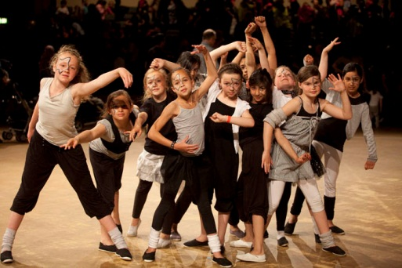
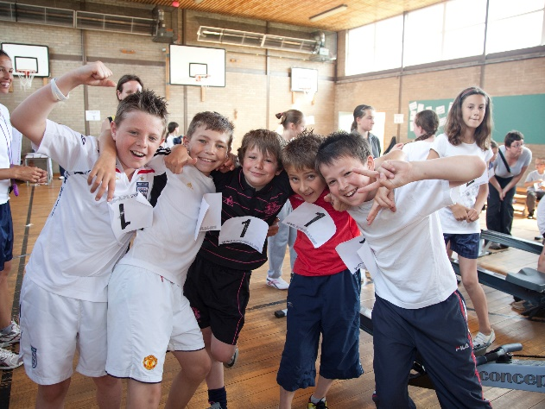
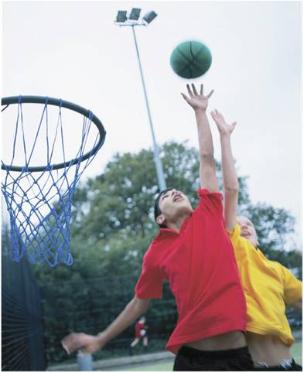
PE, Healthy Active Lifestyles (HAL) & School Sport (SS)
What does it look like in your school?
Healthy Active Lifestyles
School Sport
Physical Education
Notes:
What does, PE, Physical Activity and School Sport look like in your school?

Slide 31
Every child’s right!
INSERT CONTACT DETAILS
Notes:
Ant – do they know them….how will they role model them….what do they look like….ask ….how do DMs role model them!

